Slide 1
CS 110 Principles of Web Development
04/25/2022

Slide 2
Overview
Survey
React
Implementing an easy to-do list
Lab 3 problem-solving

Slide 3
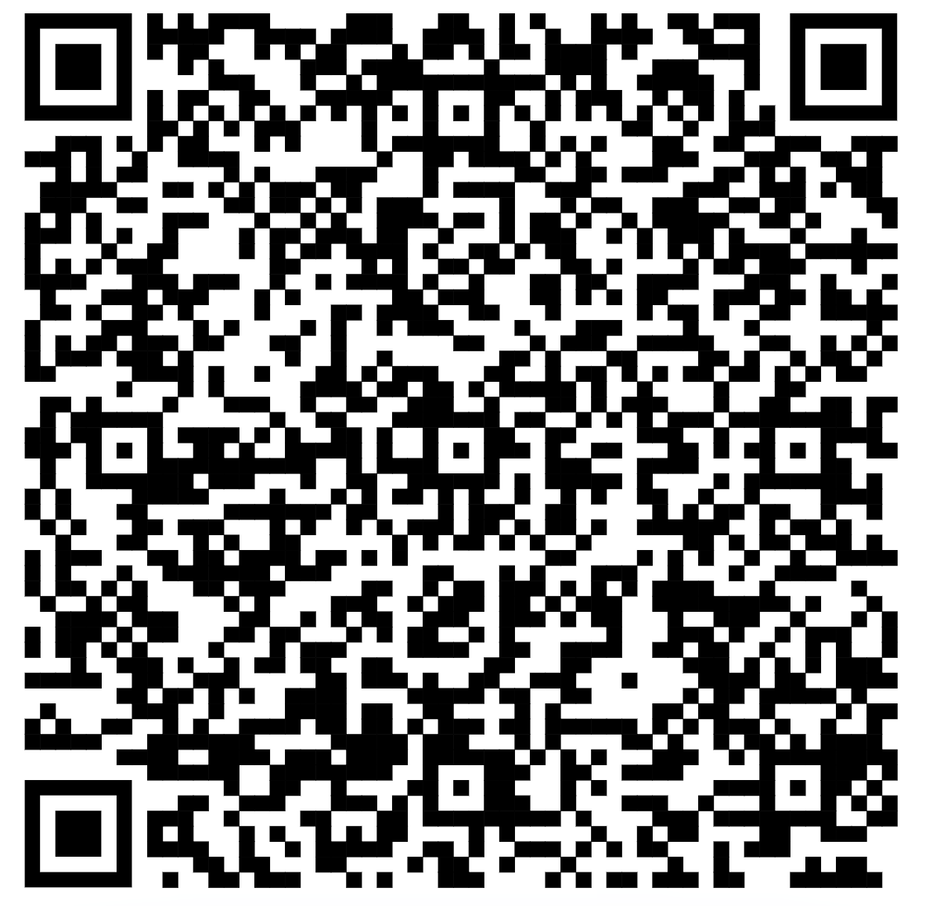
Survey

Slide 4
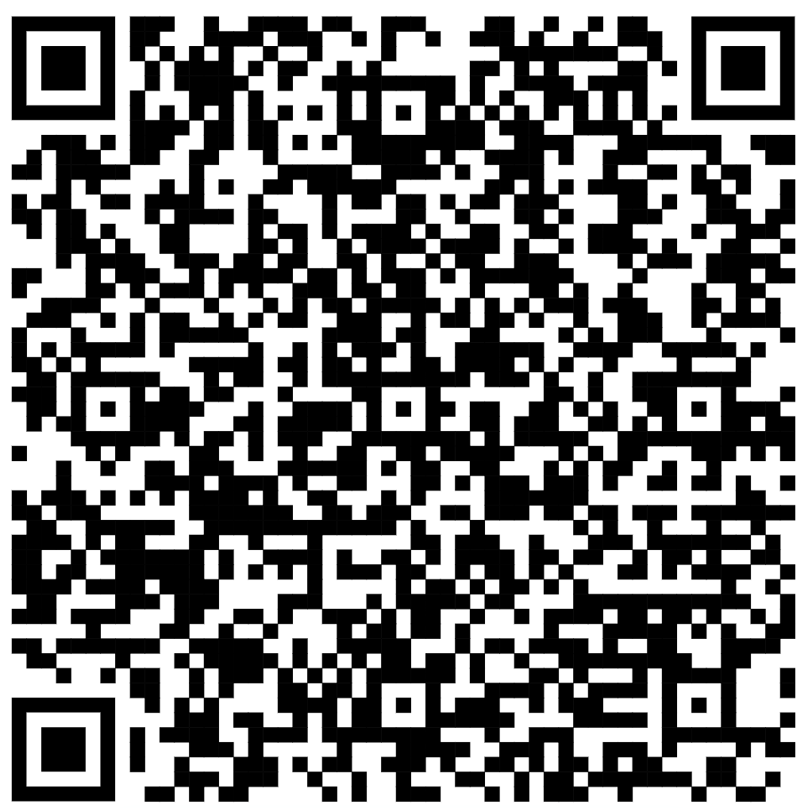
React essentials

